Slide 1
Hate Speech detection using Transformers (Deep Learning)
BY:
VARSHIT MANEPALLI
LISUM32

Slide 2
Objective
Identify and classify statements that contain offensive, derogatory, or discriminatory language directed towards individuals or groups
Develop a robust system for detecting hate speech on social media using Natural Language Processing (NLP).

Slide 3
Importance
Protect users from harmful content
Promote a safe and inclusive online environment
Assist platforms in compliance with regulations

Slide 4
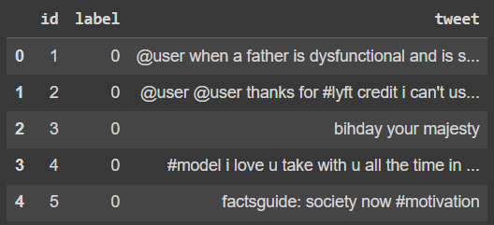
Dataset
Training dataset with labelled tweets (hate speech or non-hate speech)

Slide 5
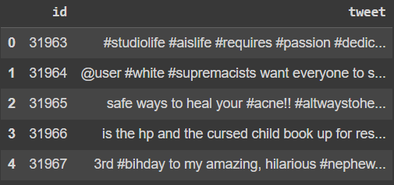
Dataset
Test dataset with unlabelled tweets for model evaluation.

Slide 6
Data Cleaning
Removing URLs, Mentions, and Hashtags
Cleaned text by removing web addresses, user mentions, and hashtags.
Converting Text to Lowercase
Standardized text to lowercase for consistency.
Removing Special Characters and Numbers
Filtered out non-alphabetic characters and digits to focus on meaningful words.

Slide 7
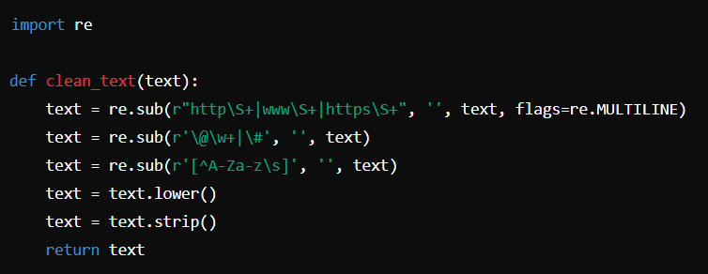
Data Cleaning
A sample code for the implementations :

Slide 8
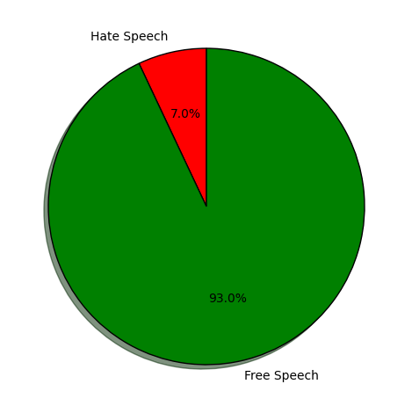
Exploratory Data Analytics(EDA)

Slide 9
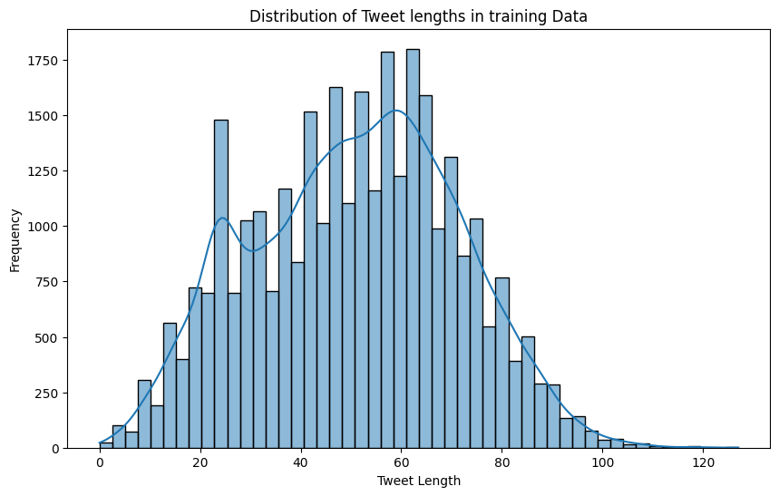
Exploratory Data Analytics(EDA)

Slide 10
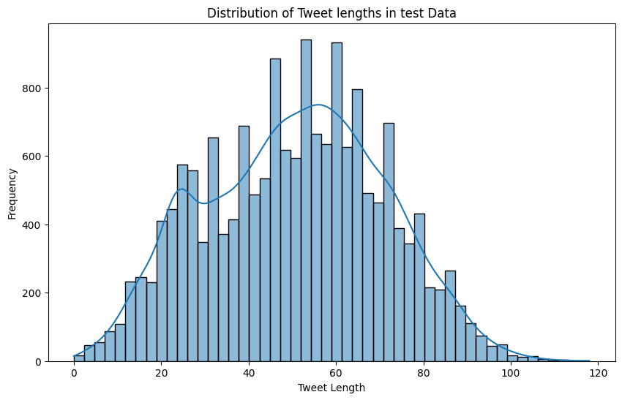
Exploratory Data Analytics(EDA)

Slide 11
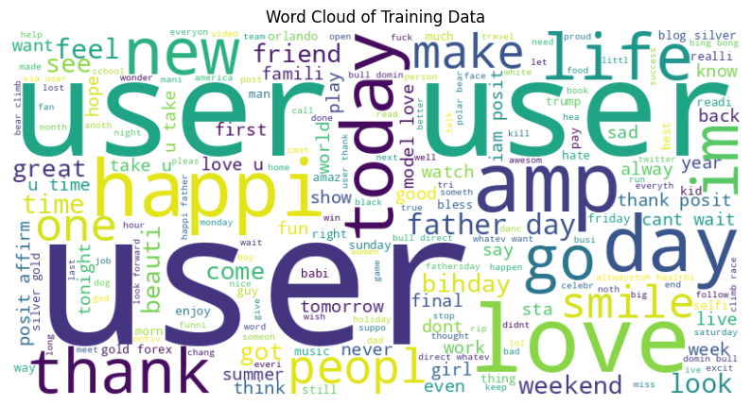
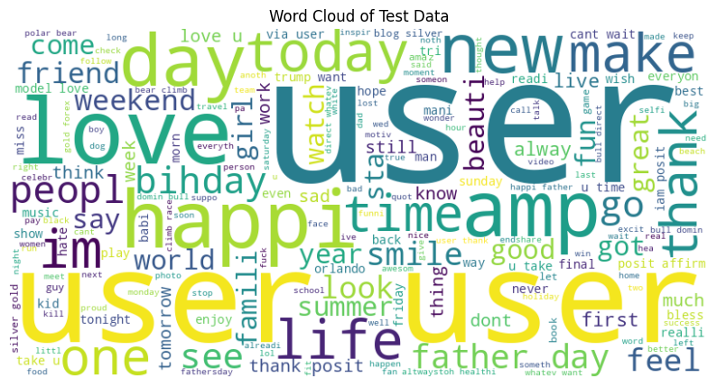
Exploratory Data Analytics(EDA)

Slide 12
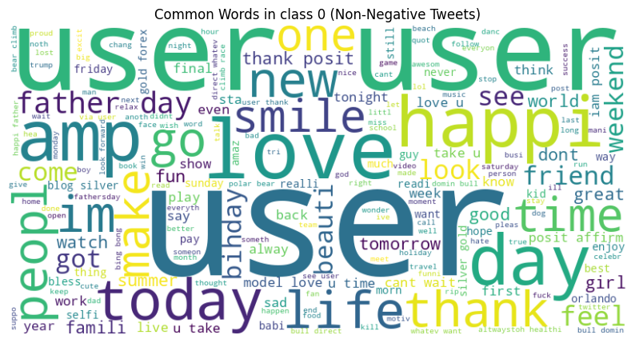
Exploratory Data Analytics(EDA)

Slide 13
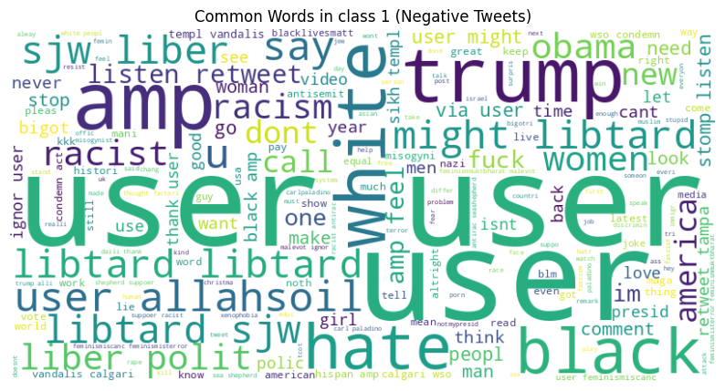
Exploratory Data Analytics(EDA)

Slide 14
Exploratory Data Analytics(EDA) Key Findings
Class Imbalance: More non-hate speech tweets compared to hate speech tweets.
Implication: Potential bias in model training if not addressed.
Tweet Lengths: Most tweets are short, typically under 100 characters.
Implication: Length distribution affects text processing and feature extraction.
Common Words: Frequent occurrence of generic terms like "user" and "thanks.“
Implication: Need for further cleaning to remove non-informative words.

Slide 15
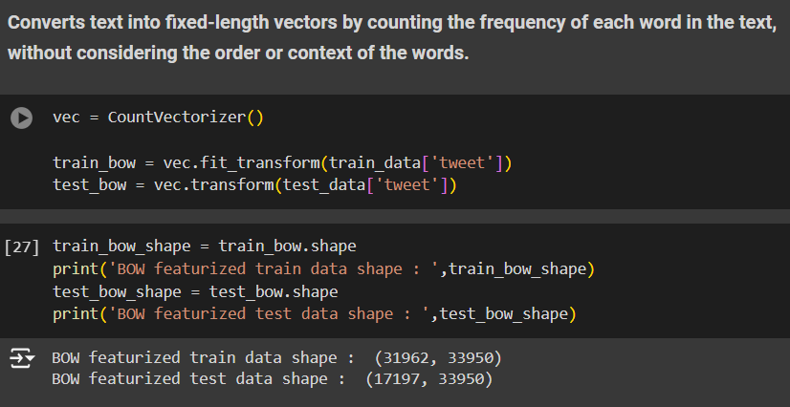
Feature Engineering
Bag of Words (BoW) : Converts text into fixed-length vectors by counting word frequency.
Usage : Basic method to transform text into numerical data.

Slide 16
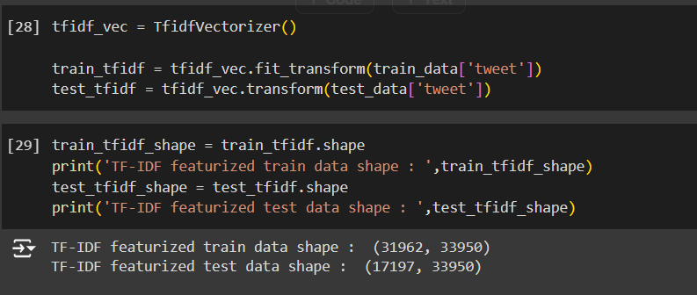
Feature Engineering
TF-IDF (Term Frequency-Inverse Document Frequency): Enhances BoW by weighing word frequency against its overall frequency across all documents.
Usage: Emphasizes unique, informative words.

Slide 17
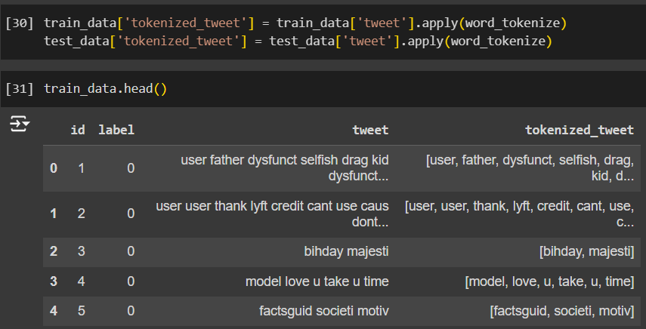
Feature Engineering
Word2Vec : Represents words as continuous vectors in a high-dimensional space, capturing semantic meaning.
Usage : Uses word co-occurrence patterns to understand context.

Slide 18
Recommended Models
Baseline Models
Logistic Regression : Simple, interpretable, good for initial benchmarks.
Random Forest : Captures non-linear relationships, suitable for diverse features.
Advanced Models
Support Vector Machines (SVM) : Effective for high-dimensional spaces, particularly text data.
Neural Networks : Deep learning models for large datasets and complex features.
Transformer-based Models (e.g., BERT) : State-of-the-art for NLP tasks, understanding context and semantics deeply.

Slide 19
Selected Model
We will Implement Transformer-based Models for this project
Reason
State of the Art Performance : These models are known for achieving state-of-the-art performance in various NLP tasks, including text classification and sentiment analysis.
Contextual Understanding : They can understand the context of a word in a sentence by considering both the left and right context simultaneously. This bidirectional approach allows for a deeper understanding.
Adaptability : They are highly adaptable to various NLP tasks with minimal modifications, making them versatile tools for different aspects of text analysis and classification.

Slide 20
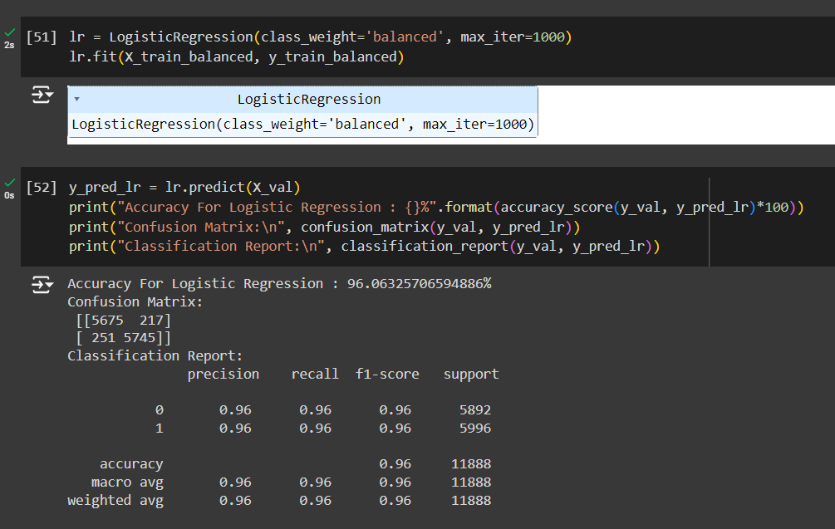
Linear Model (Logistic Regression)

Slide 21
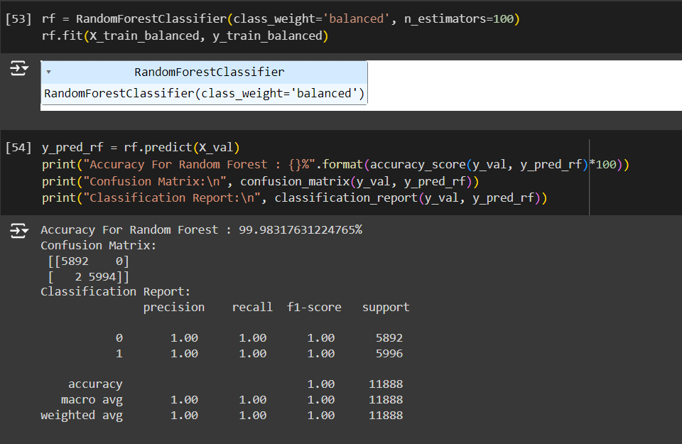
Ensemble Model (Random Forest Classifier)

Slide 22
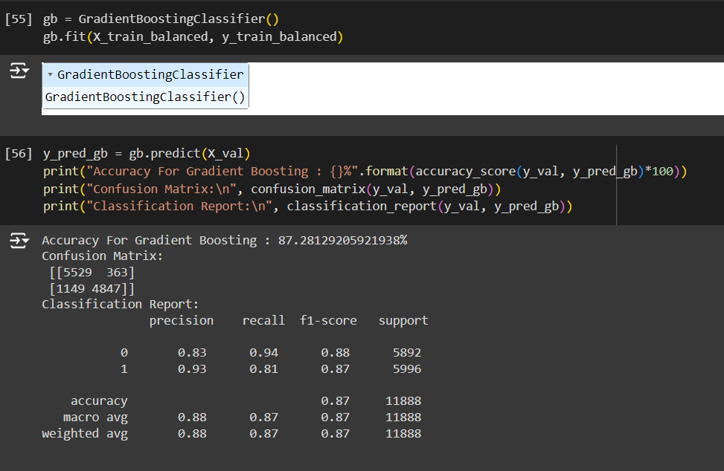
Boosting Model(Gradient Boosting Classifier)

Slide 23

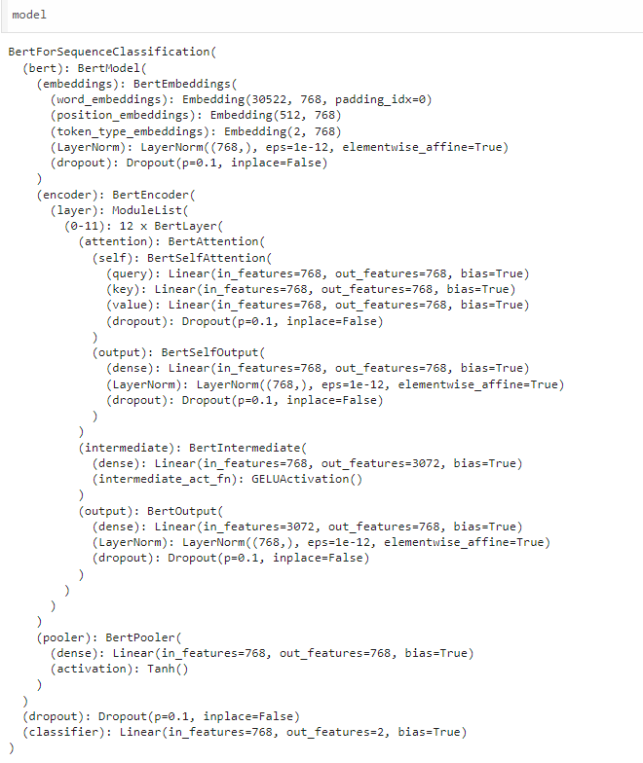
Transformers Model (BERT)

Slide 24
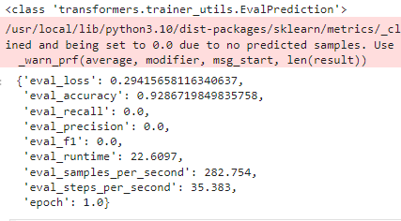
Transformers Model (BERT)

Slide 25
Future Developments
Advanced NLP Techniques:
Integrate more sophisticated Natural Language Processing (NLP) techniques and models like BERT, GPT, or transformers to enhance the accuracy of hate speech detection.
Multilingual Support:
Expand the model to detect hate speech in multiple languages, making it more versatile and applicable globally.
Real-time Monitoring:
Develop capabilities for real-time monitoring and detection of hate speech on social media platforms and other online forums.
Contextual Understanding:
Improve the model’s ability to understand context, reducing false positives and negatives by considering the broader conversation.
User Feedback Integration:
Implement a user feedback mechanism to refine and improve the model based on real-world use cases and inputs.
Ethical AI Practices:
Ensure the model adheres to ethical AI guidelines, minimizing biases and promoting fairness in detection results

Slide 26
Conclusion
Summary
Our Hate Speech Detection project aims to tackle the pervasive issue of online hate speech by employing advanced Machine Learning and NLP techniques to accurately classify harmful content.
Impact
This tool contributes to creating a safer online environment by identifying and mitigating the spread of hate speech on platforms like Twitter.
User-Friendly
Designed to be accessible and effective, our model can be utilized by various organizations and individuals to monitor and address hate speech in real time.
Future Potential
With planned advancements, our project is poised to become even more robust, supporting multiple languages, real-time monitoring, and better contextual understanding.
Call to Action
We encourage stakeholders to adopt this tool, provide valuable feedback, and collaborate with us in the fight against online hate speech through innovative technology.

Slide 27

Thank You

